Slide 1
Python Programming
Giridher Sadineni
Skillverse IT Training & Development Pvt. Ltd.

Slide 2
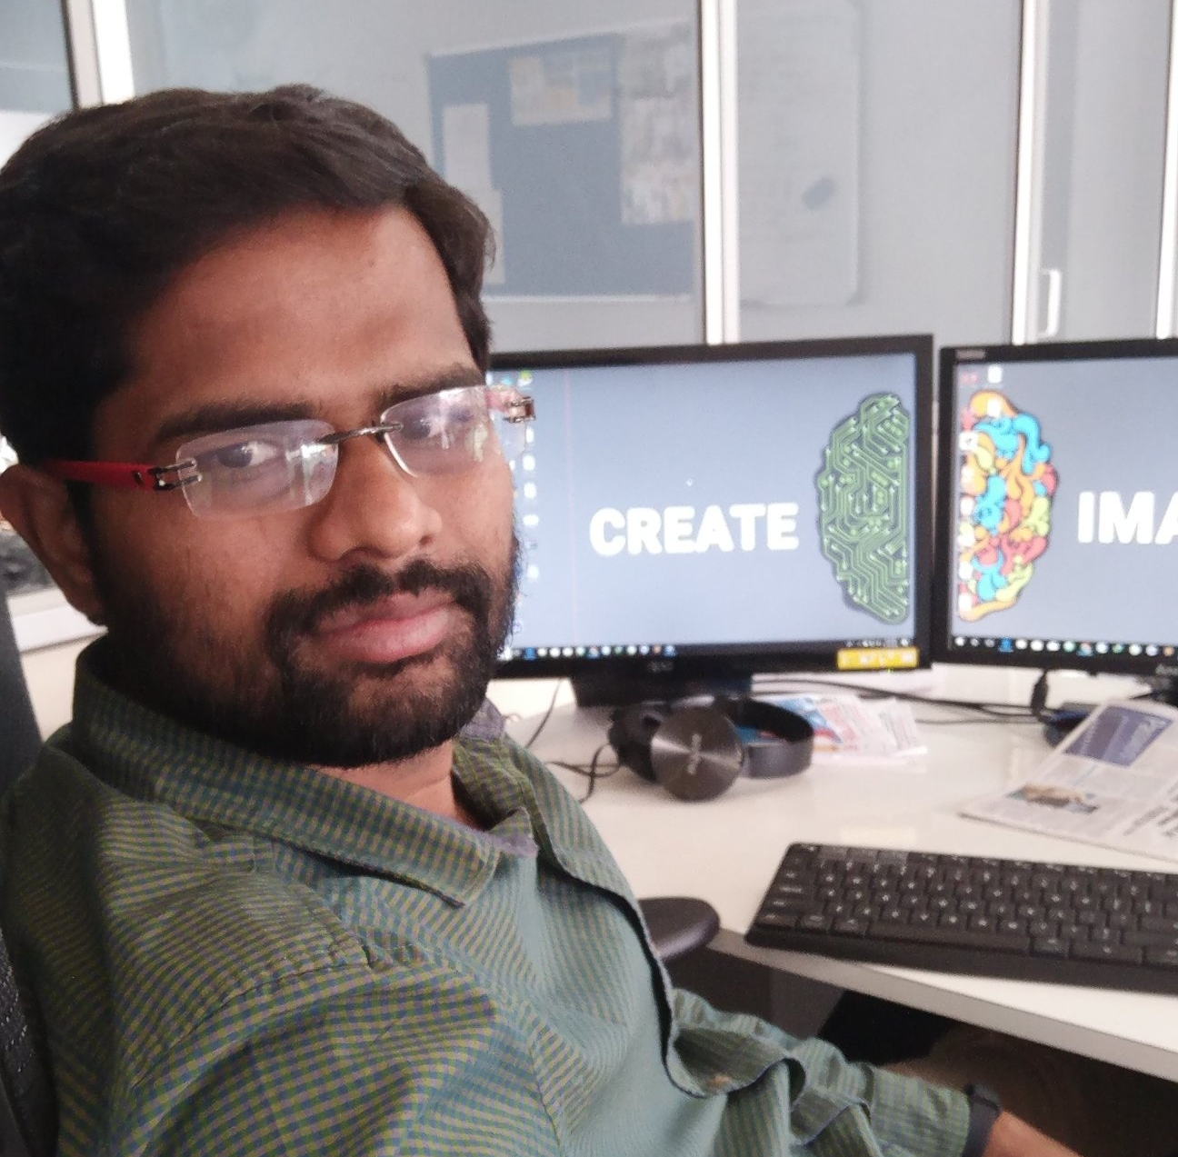
About Me
Learn
Teach
Code
Repeat
Follow me @ github.com/giridhersadineni

Slide 3
Agenda for Today
Lets Learn Python

Slide 4
Python Language
Python is a general-purpose interpreted, interactive, object-oriented, and high-level programming language.
It is Free and developed by Open Source Community Python Software Foundation

Slide 5
History
It was created by Guido van Rossum during 1985- 1990.
It is influenced by Modula 3 & ABC Programming Language

Slide 6
Features
Easy-to-learn -read - maintain
Portable
Supports Popular Databases (MySQL, MSSQL, MongoDB
GUI Programming (Tkinter)
Scalable
Vast Library

Slide 7
Application (Python Usage)
Web and Internet Development
Desktop GUI Applications
Scientific and Numeric
Education
Business Applications
Games and 3D Graphics
Network Programming
Database Access

Slide 8
Which Version ???
Python 2.7
Python 3.X (Latest : 3.7.3)

Slide 9
Lets Start

Slide 10
Installing Python
Goto www.python.org/downloads
Download Version 3.5 if your Operating System is (Windows 7 / XP)
Download Latest Release if your Os in Windows 8 / 8.1 / 10
In Linux / MacOS Version 2.7 is already installed

Slide 11
Getting Started with Python : Setting Path
To add the Python directory to the path for a particular session in Unix −
In the csh shell − type setenv PATH "$PATH:/usr/local/bin/python" and press Enter.
In the bash shell (Linux) − type export PATH="$PATH:/usr/local/bin/python" and press Enter.
In the sh or ksh shell − type PATH="$PATH:/usr/local/bin/python" and press Enter.
Note − /usr/local/bin/python is the path of the Python directory

Slide 12
Choose Your Editor
Visual Studio Code => http://code.visualstudio.com
PyCharm => https://www.jetbrains.com/pycharm/
Python (IDLE Bundled with Python Installler)
Notepad + Console

Slide 13

Get Set Go

Slide 14
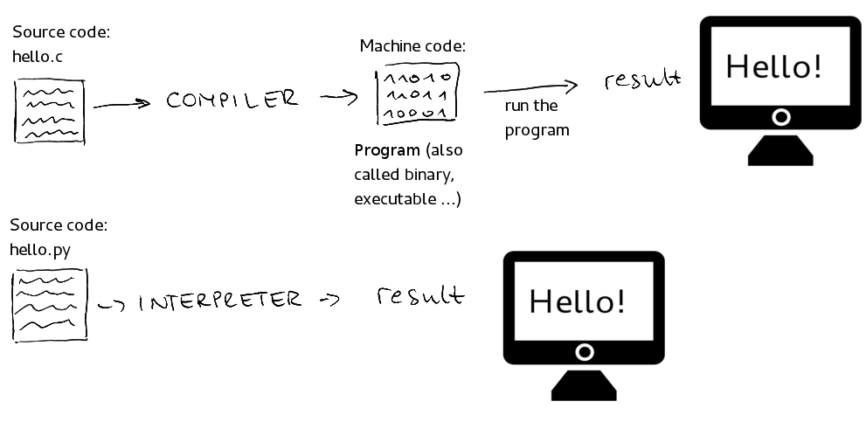
Interpreted vs Compiled

Slide 15
2 Ways to Interact with Python
Interactive Mode | Normal Mode
Take Single User Input, Evaluates them and returns to the User | Executes a Python script on Command Line

Slide 16
Interactive Mode
C:\Users\PC>python
Python 3.7.0 (v3.7.0:1bf9cc5093, Jun 27 2018, 04:59:51) [
Type "help", "copyright", "credits" or "license" for more information.
>>> print “Hello”
Hello
>>>

Slide 17
Normal Mode
C:\Users\PC>python hello.py
Hello
Filename : hello.py
print “Hello”

Slide 18
Language Basics : Variables

Slide 19
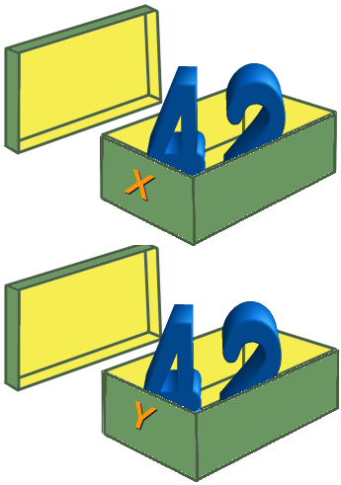
Python Variables
Variable is something which can change.
A variable is a way of referring to a memory location used by a computer program.
This memory location contains values, like numbers, text or more complicated types.
A variable has a name, type, a scope, and above all a value.

Slide 20
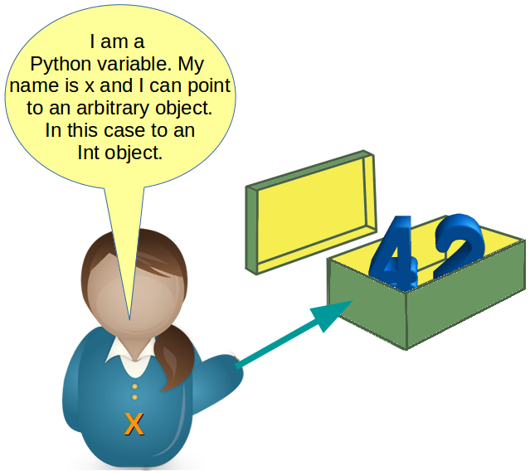

Slide 21
Rules for Naming a Variable
A valid identifier is a non-empty sequence of characters of any length with: The start character can be the underscore "_" or a capital or lower case letter.
The letters following the start character can be anything which is permitted as a start character plus the digits.
Variable names are Case sensitive (Apple != apple)
Python keywords are not allowed as identifier names! See list in next slide

Slide 22
Keywords = Reserved Names
and, as, assert, break, class, continue, def, del, elif, else, except, exec, finally, for, from, global, if, import, in, is, lambda, not, or, pass, print, raise, return, try, while, with, yield

Slide 23
Creating a Variable
>>> x = 42
>>> print(x) 42
>>> x = "Now x references a string"
>>> print(x)
Now x references a string

Slide 24
Data Types
A Data type Specifies the type of data stored inside the Variable
Python's built-in core data types are in some cases also called object types. There are four built-in data types for numbers:
Integer
Long integers
Floating-point numbers,
** Complex numbers are written as <real part> + <imaginary part>j

Slide 25
Complex Number Arithmetic
examples: >>> x = 3 + 4j >>> y = 2 - 3j >>> z = x + y >>> print z (5+1j)

